Slide 1


Data Structures
Week7_Lecture1
Stacks
Subhan Ullah, PhD
subhan.ullah@nu.edu.pk
BS(Cybersecurity) Fall-2023

Slide 2
Stack
A stack is a special kind of list
Insertion and deletions takes place at one end called top
Other names
Push down list
Last In First Out (LIFO)

Slide 3
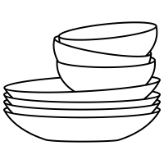

Stack Examples
Books on floor
Dishes on a shelf

Slide 4
Stack ADT
Stack ADT emphasizes specific operations
Uses an explicit linear ordering
Insertions and removals are performed individually
Inserted objects are pushed onto the stack
Top of the stack is the most recently pushed object onto the stack
When an object is popped from the stack, the current top is erased

Slide 5
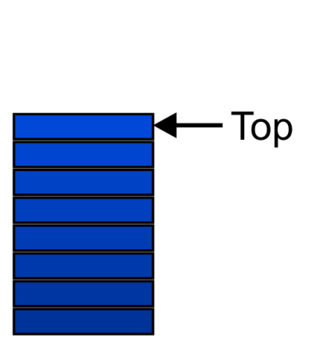
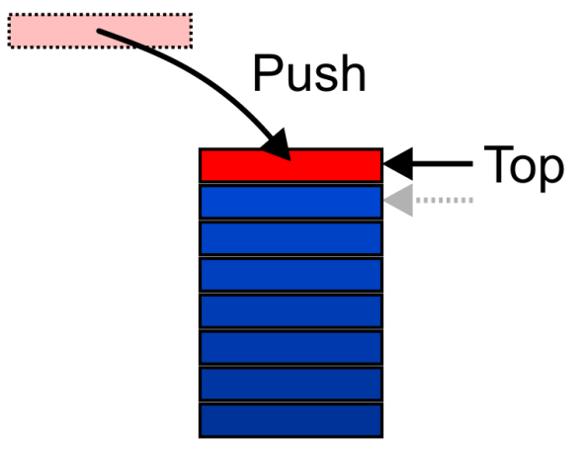
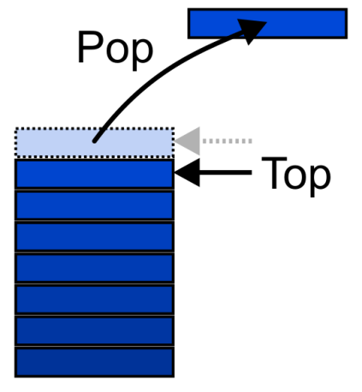
Stack ADT – Operations (1)
Graphically, the stack operations are viewed as follows:

Slide 6
Stack ADT – Operations (2)
MAKENULL(S)
Make Stack S be an empty stack
TOP(S)
Return the element at the top of stack S
POP(S)
Remove the top element of the stack
PUSH(S,x)
Insert the element x at the top of the stack
EMPTY(S)
Return true if S is an empty stack and return false otherwise

Slide 7
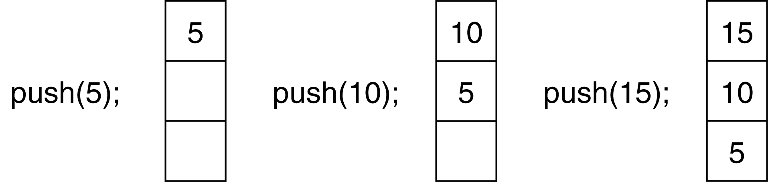
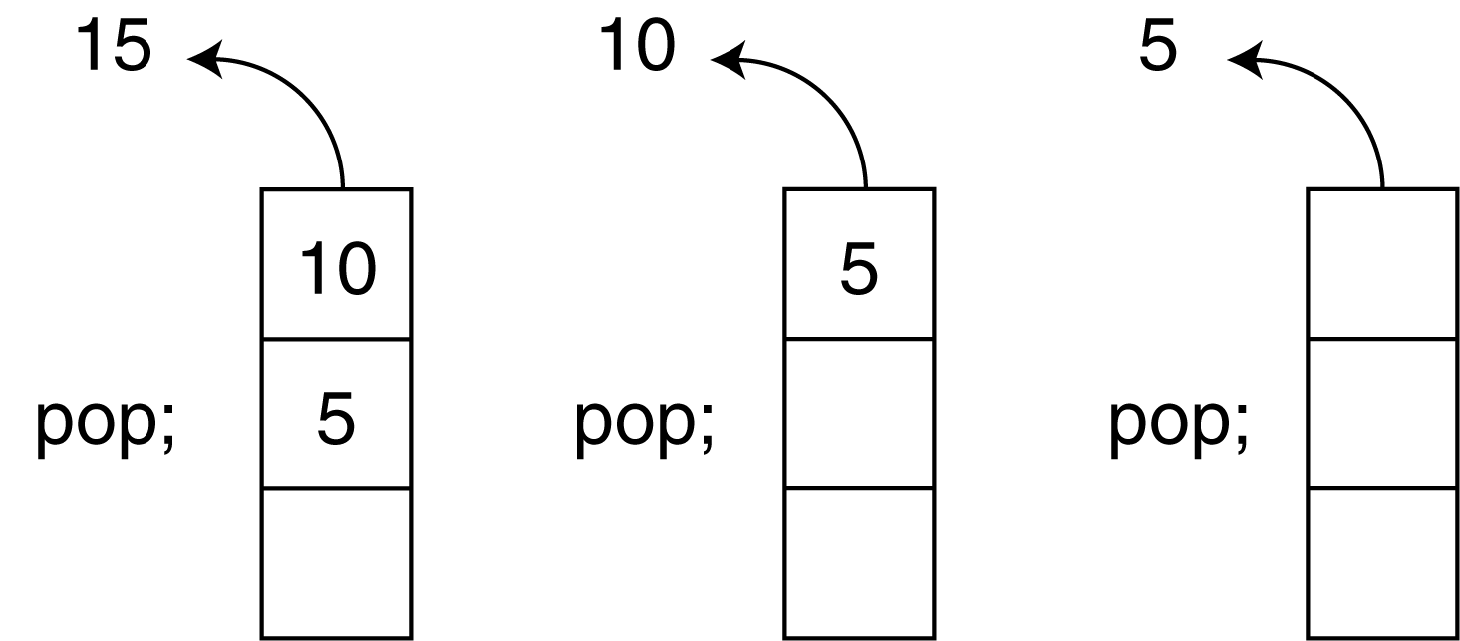
Push and Pop Operations of Stack

Slide 8
Applications (1)
Many applications
Parsing code
Matching parenthesis
XML (e.g., XHTML)
Tracking function calls
Dealing with undo/redo operations
The stack is a very simple data structure
Given any problem, if it is possible to use a stack, this significantly simplifies the solution

Slide 9
Applications (2)
Problem solving
Solving one problem may lead to subsequent problems
These problems may result in further problems
As problems are solved, focus shifts back to the problem which lead to the solved problem
Notice that function calls behave similarly
A function is a collection of code which solves a problem

Slide 10
Use of Stack in Function Calls (1)
When a function begins execution an activation record is created to store the current execution environment for that function
Activation record contains all the necessary information about a function call, including
Parameters passed by the caller function
Local variables
Content of the registers
(Callee) Function’s return value(s)
Return address of the caller function
Address of instruction following the function call

Slide 11
Use of Stack in Function Calls (2)
Each invocation of a function has its own activation record
Recursive/Multiple calls to the functions require several activation records to exist simultaneously
A function returns only after all functions it calls have returned Last In First Out (LIFO) behavior
A program/OS keeps track of all the functions that have been called using run-time stack

Slide 12
Runtime Stack Example (1)
void main(){
int a=3;
f1(a); // statement A
cout << endl;
}
void f1(int x){
cout << f2(x+1); // statement B
}
int f2(int p){
int q=f3(p/2); // statement C
return 2*q;
}
int f3(int n){
return n*n+1;
}

Slide 13
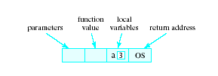
Runtime Stack
When a function is called …
Copy of activation record pushed onto run-time stack
Arguments copied into parameter spaces
Control transferred to starting address of body of function
Return value
Function value
Local variables
Parameters
Return address
OS denotes that when execution of main() is completed, it returns to the operating system

Slide 14
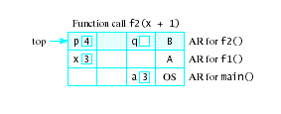
Runtime Stack Example (2)
void main(){
int a=3;
f1(a); // statement A
cout << endl;
}
void f1(int x){
cout << f2(x+1); // statement B
}
int f2(int p){
int q=f3(p/2); // statement C
return 2*q;
}
int f3(int n){
return n*n+1;
}

Slide 15
Static and Dynamic Stacks
Two possible implementations of stack data structure
Static, i.e., fixed size implementation using arrays
Dynamic implementation using linked lists

Slide 16
Array-based Implementation

Slide 17
Array Implementation – First Solution (1)
Elements are stored in contiguous cells of an array
New elements can be inserted to the top of the list
top
First Element
Second Element
List
Last Element
Empty
maxlength

Slide 18
Array Implementation – First Solution (2)
Problem
Every PUSH and POP requires moving the entire array up and down
1
2
3
2
1
2
1
1
…

Slide 19
Array Implementation – Better Solution (2)
Idea
Anchor the top of the stack at the bottom of the array
Let the stack grow towards the top of the array
Top indicates the current position of the first stack element
Empty
top
First Element
Second Element
List
…
maxlength
Last Element

Slide 20
Array Implementation – Code (1)
#ifndef INTSTACK_H #define INTSTACK_H class IntStack { private: int *stackArray; int stackSize; int top; public: IntStack(int);
~IntStack( ); void push(int); void pop(int &); bool isFull(void); bool isEmpty(void); }; #endif

Slide 21
Array Implementation – Code (2)
Constructor
IntStack::IntStack(int size) //constructor { stackArray = new int[size]; stackSize = size; top = -1; }
Destructor
IntStack::~IntStack(void) //destructor
{ delete [] stackArray;
}

Slide 22
Array Implementation – Code (3)
isFull function
bool IntStack::isFull(void) { bool status; if (top == stackSize - 1) status = true; else status = false; return status; // return (top == stackSize-1); }
isEmpty function
bool IntStack::isEmpty(void)
{
return (top == -1); }

Slide 23
Array Implementation – Code (4)
push function inserts the argument num onto the stack
void IntStack::push(int num) { if (isFull())
{
cout << "The stack is full.\n";
}
else
{
top++;
stackArray[top] = num;
} }

Slide 24
Array Implementation – Code (5)
Pop function removes the value from top of the stack and returns it as a reference
void IntStack::pop(int &num)
{
if (isEmpty())
{
cout << "The stack is empty.\n";
}
else
{
num = stackArray[top];
top--;
}
}

Slide 25
Using Stack (1)
void main(void) { IntStack stack(4);
}
stackArray
[0]
top
-1
[1]
stackSize
4
[2]
[3]

Slide 26
Using Stack (2)
void main(void) { IntStack stack(4); int catchVar;
cout << "Pushing Integers\n"; stack.push(5); stack.push(10); stack.push(15); stack.push(20);
}
stackArray
5
[0]
top
3
10
[1]
stackSize
4
15
[2]
20
[3]

Slide 27
Using Stack (3)
void main(void) { IntStack stack(4); int catchVar;
cout << "Pushing Integers\n"; stack.push(5); stack.push(10); stack.push(15); stack.push(20);
cout << "Popping...\n"; stack.pop(catchVar); cout << catchVar << endl;
}
num
20
stackArray
5
[0]
top
2
10
[1]
stackSize
4
15
[2]
[3]

Slide 28
Using Stack (4)
void main(void) { IntStack stack(4); int catchVar;
cout << "Pushing Integers\n"; stack.push(5); stack.push(10); stack.push(15); stack.push(20);
cout << "Popping...\n"; stack.pop(catchVar); cout << catchVar << endl; stack.pop(catchVar); cout << catchVar << endl; stack.pop(catchVar); cout << catchVar << endl; stack.pop(catchVar); cout << catchVar << endl;
}
Output:
Pushing Integers
Popping…
20
15
10
5

Slide 29
Pointer-based Implementation

Slide 30
Pointer-based Implementation of Stacks
Stack can expand or shrink with each push or pop operation
Push and pop operate only on the header cell, i.e., the first cell of the list
.
Top
x
y
z

Slide 31
Pointer Implementation – Code (1)
class Stack
{
struct node
{
int data;
node *next;
};
public:
void Push(int newelement);
void Pop(int &);
bool IsEmpty();
};

Slide 32
Pointer Implementation – Code (2)
IsEmpty function returns true if the stack is empty
bool Stack::IsEmpty()
{
if (top==NULL)
{
return true;
}
else
{
return false;
}
}

Slide 33
Pointer Implementation – Code (3)
Push function inserts a node at the top/head of the stack
void Stack::Push(int newelement)
{
node *newptr;
newptr=new node;
newptr->data=newelement;
newptr->next=top;
top=newptr;
}

Slide 34
Pointer Implementation – Code (4)
Pop function deletes the node from the top of the stack and returns its data by reference
void Stack:Pop(int& returnvalue)
{
if (IsEmpty())
{
cout<<“underflow error”;
return;
}
tempptr = top;
returnvalue = top->data;
top = top->next;
delete tempptr;
}

Slide 35

Time Complexity (Array implementation)
For one-ended arrays, all operations at the back are Θ(1)
 | Front/1st | Back/n^{th}
Find | Θ(1) | Θ(1)
Insert | Θ(n) | Θ(1)
Erase | Θ(n) | Θ(1)

Slide 36
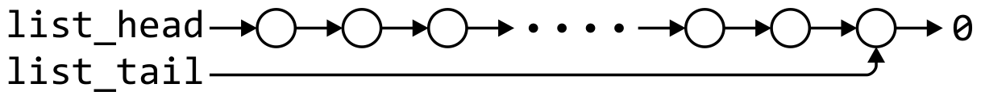
Time complexity (linked list implementation)
Operations at the front of a singly linked list are all Θ(1)
The desired behaviour of an Abstract Stack may be reproduced by performing all operations at the front
 | Front/1st | Back/n^{th}
Find | Θ(1) | Θ(1)
Insert | Θ(1) | Θ(1)
Erase | Θ(1) | Θ(n)

Slide 37
Parsing XHTML
The first example will demonstrate parsing XHTML
We will show how stacks may be used to parse an XHTML document
You will use XHTML (and more generally XML and other markup languages) in the workplace

Slide 38
Parsing XHTML
A markup language is a means of annotating a document to given context to the text
The annotations give information about the structure or presentation of the text
The best known example is HTML, or HyperText Markup Language
We will look at XHTML

Slide 39
Parsing XHTML
XHTML is made of nested
opening tags, e.g., <some_identifier>, and
matching closing tags, e.g., </some_identifier>
<html>
<head><title>Hello</title></head>
<body><p>This appears in the <i>browser</i>.</p></body>
</html>

Slide 40
Parsing XHTML
Nesting indicates that any closing tag must match the most recent opening tag
Strategy for parsing XHTML:
read though the XHTML linearly
place the opening tags in a stack
when a closing tag is encountered, check that it matches what is on top of the stack and

Slide 41
Parsing XHTML
<html>
<head><title>Hello</title></head>
<body><p>This appears in the <i>browser</i>.</p></body>
</html>
<html>

Slide 42
Parsing XHTML
<html>
<head><title>Hello</title></head>
<body><p>This appears in the <i>browser</i>.</p></body>
</html>
<html> | <head>

Slide 43
Parsing XHTML
<html>
<head><title>Hello</title></head>
<body><p>This appears in the <i>browser</i>.</p></body>
</html>
<html> | <head> | <title>

Slide 44
Parsing XHTML
<html>
<head><title>Hello</title></head>
<body><p>This appears in the <i>browser</i>.</p></body>
</html>
<html> | <head> | <title>

Slide 45
Parsing XHTML
<html>
<head><title>Hello</title></head>
<body><p>This appears in the <i>browser</i>.</p></body>
</html>
<html> | <head>

Slide 46
Parsing XHTML
<html>
<head><title>Hello</title></head>
<body><p>This appears in the <i>browser</i>.</p></body>
</html>
<html> | <body>

Slide 47
Parsing XHTML
<html>
<head><title>Hello</title></head>
<body><p>This appears in the <i>browser</i>.</p></body>
</html>
<html> | <body> | <p>

Slide 48
Parsing XHTML
<html>
<head><title>Hello</title></head>
<body><p>This appears in the <i>browser</i>.</p></body>
</html>
<html> | <body> | <p> | <i>

Slide 49
Parsing XHTML
<html>
<head><title>Hello</title></head>
<body><p>This appears in the <i>browser</i>.</p></body>
</html>
<html> | <body> | <p> | <i>

Slide 50
Parsing XHTML
<html>
<head><title>Hello</title></head>
<body><p>This appears in the <i>browser</i>.</p></body>
</html>
<html> | <body> | <p>

Slide 51
Parsing XHTML
<html>
<head><title>Hello</title></head>
<body><p>This appears in the <i>browser</i>.</p></body>
</html>
<html> | <body>

Slide 52
Parsing XHTML
<html>
<head><title>Hello</title></head>
<body><p>This appears in the <i>browser</i>.</p></body>
</html>
<html>

Slide 53
Parsing XHTML
We are finished parsing, and the stack is empty
Possible errors:
a closing tag which does not match the opening tag on top of the stack
a closing tag when the stack is empty
the stack is not empty at the end of the document

Slide 54


